Slide 1
Olympics Data Analysis Project Proposal For SportsStats
June 2021
Leslie Nwangwu
Background Photo by Markus Spiske on Unsplash

Slide 2
Contents
Review of Questions to Answer/ Hypothesis/ Approach
Technical Challenges
Detail: Entity Relationship Diagram (ERD)
Initial Findings
Further Analysis
Hypothesis Results and Recommendations
Appendix

Slide 3
Questions to Answer
Which Sport do African Athletes participate in the most?
To understand which sport they are most interested in/ have access to
To see if there is overwhelming representation in a particular Sport
What Sport do they excel in?
To get an idea of which Sports, if any, they win most of their medals
To see if there is a correlation with question 1

Slide 4
Initial Hypothesis
African athletes perform better in events that have the least barriers to entry, i.e. equipment cost.
The Sports that require the less equipment will have better representation for African athletes.
The Sports with more equipment requirement will see less representation of African athletes.

Slide 5
Data Analysis Approach
The analysis will be done using the Olympics Dataset - 120 years of data
Aggregate functions.
To determine which sports African athletes won medals in grouped by Country.
To see if more medals have been won in any particular Sport than others.
To group the athletes participating in the games by Sport and see if any Sport is heavily represented.
Comparative analysis.
To see if the results of the analysis are unique to African contingents.
Determine if any other pattern emerges.

Slide 6
Technical Challenges
The dataset did not have countries grouped by continent. This was resolved by getting the requisite continental country grouping data from unstats.un.org and then inserting it into the dataset.

Slide 7
Entity Relationship Diagram
Athlete_Event
ID
Name
Sex
Age
Height
Weight
Team
NOC
Games
Year
Season
City
Sport
Event
Medal
NOC_regions
NOC
Country
Notes
Continent*
Primary Key
Primary Key
Secondary Key
* The continent column was inserted into the NOC_regions table

Slide 8
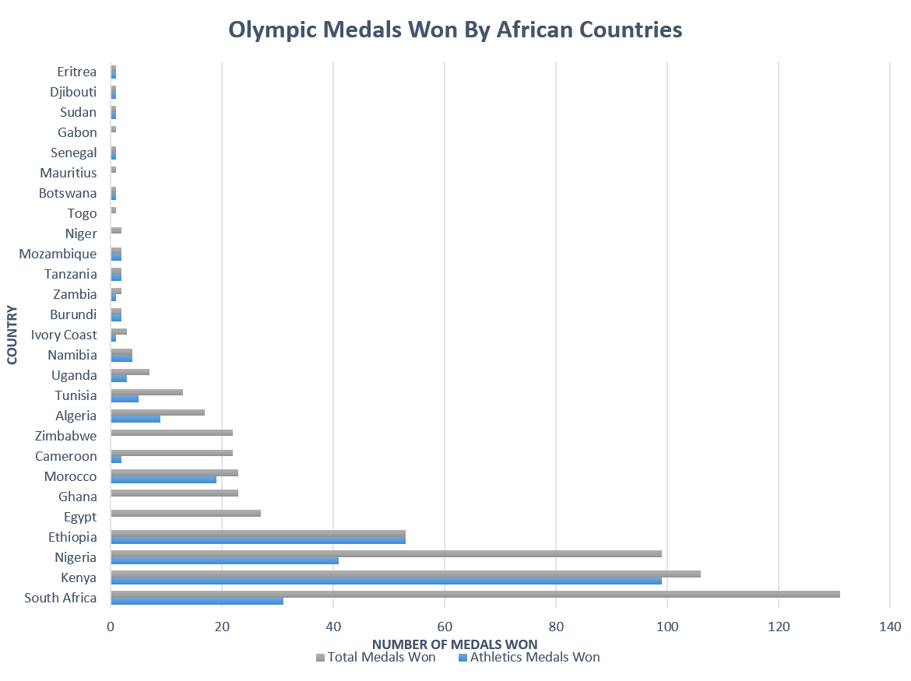
Initial Findings
Athletics has the highest number of athletes of all sports on all continents
Overwhelming performance in Athletics
can be seen in most countries across the
African continent
Most expensive Sport | ICE HOCKEY
Least expensive Sport | ATHLETICS
costs measured: registration, equipment, travel, camps, other
Source: money.com
Athletics contingents as a percentage of total athletes for each Continent
Africa | 33%
Americas | 21%
Europe | 17%
Asia | 16%
Oceania | 15%

Slide 9
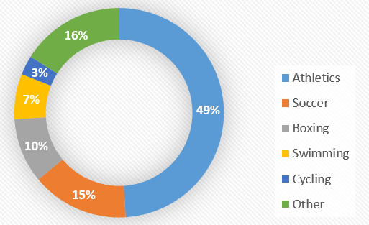
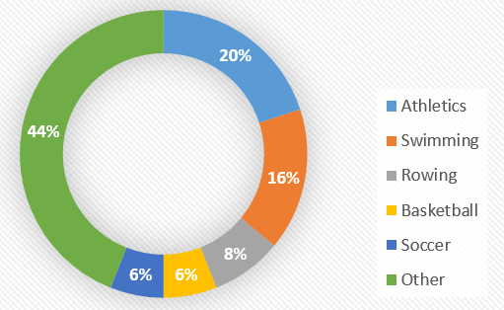
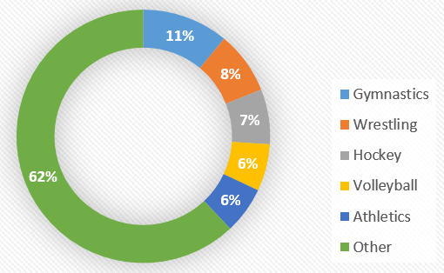
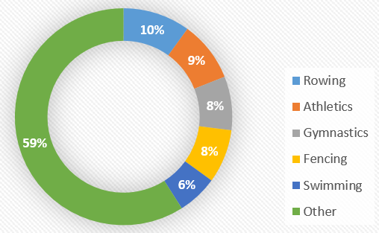
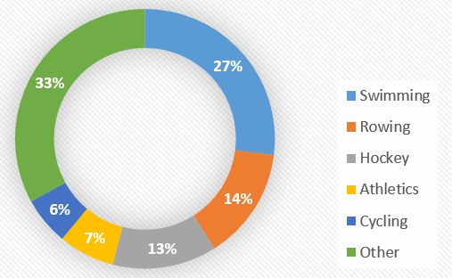
Further Analysis
Medals Won by each Continent Grouped by Sport
AFRICA
AMERICAS
ASIA
EUROPE
OCEANIA
Athletics accounts for half of Africa’s medals.
Such inordinate performance in a single sport is clearly unique to Africa.

Slide 10
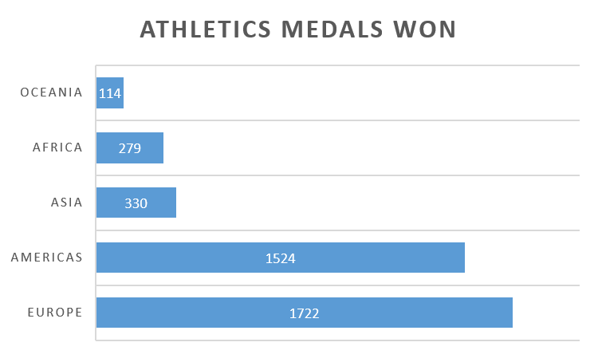
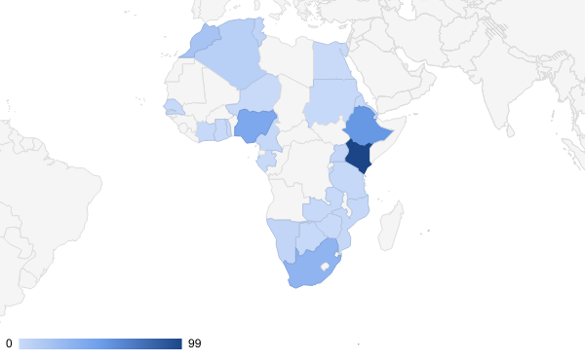
Further Analysis 2
Athletics medals won grouped by continent
Athletics medals distribution across Africa
Africa is not the most successful continent regarding athletics medals, hence the findings are not skewed by number of athletics medals won.
The athletics medals distribution is spread across Africa and not concentrated in any particular region, further evidence that the findings are not skewed.

Slide 11
Hypothesis Results
African athletes do have a heavy representation in one sport, Athletics.
Athletics is the sport that is most represented on all the continents, however, this is particularly emphasized in Africa where athletics accounts for one-third of all African Olympic athletes.
Athletics, Soccer, and Boxing account for 76% of all medals won by African athletes, with Athletics alone accounting for 49% of total medals won.
The findings clearly indicate that African athletes do perform better in events that have the least barriers to entry, i.e. equipment cost.
Recommendations
Athletics should be the immediate focus of any Sports brand looking to enter the African market.
There is enormous opportunity for the development of facilities/equipment in other sports on the continent.

Slide 12

THANK YOU

Slide 13
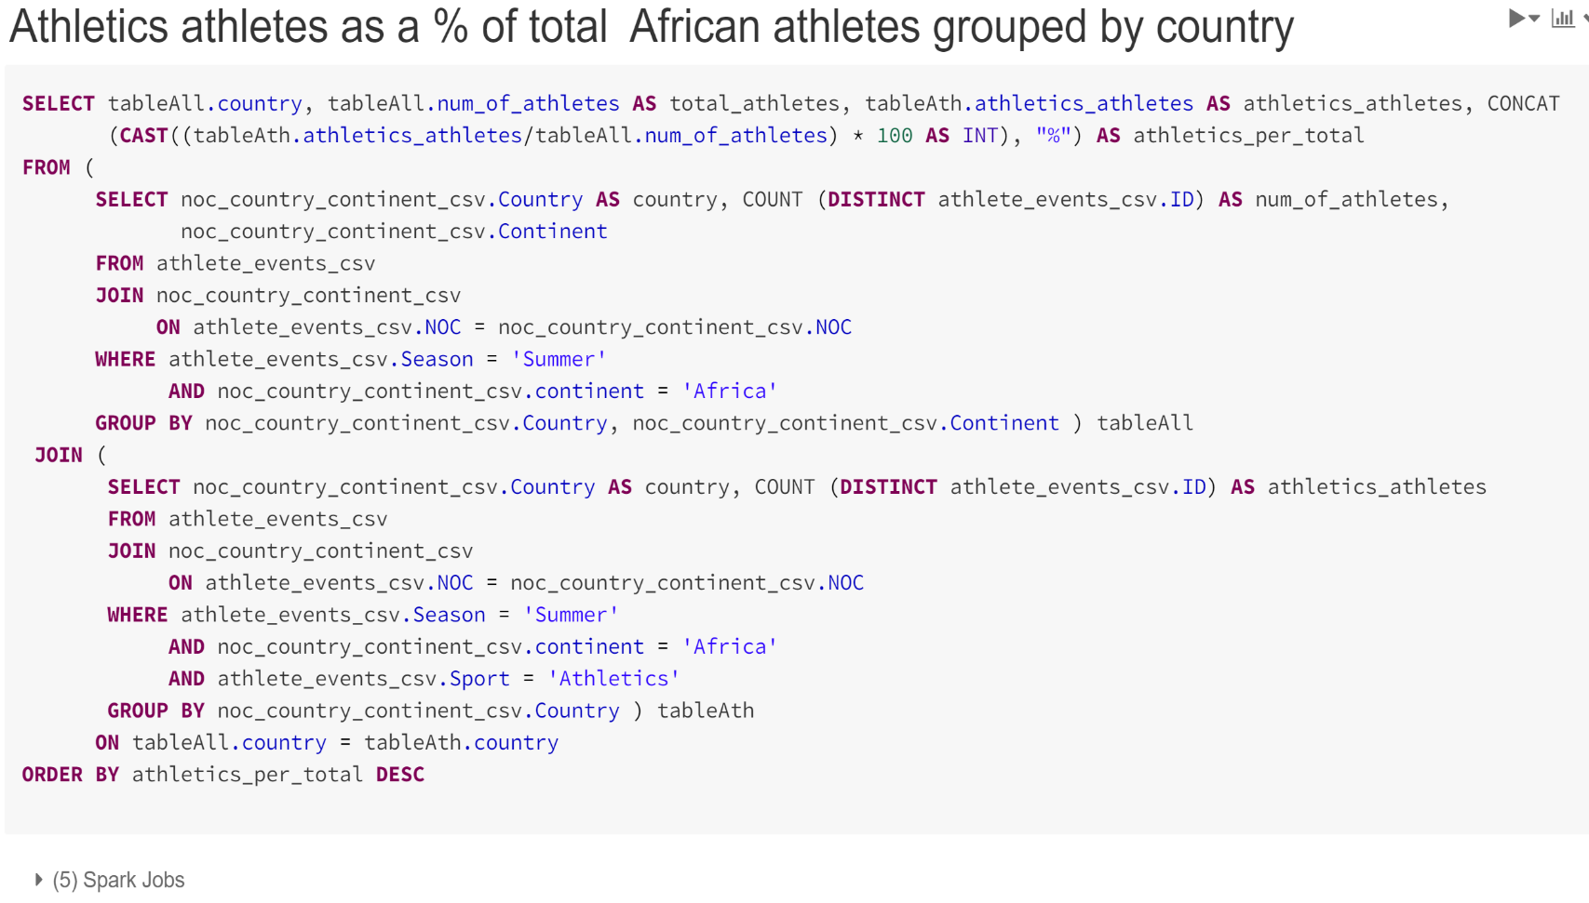
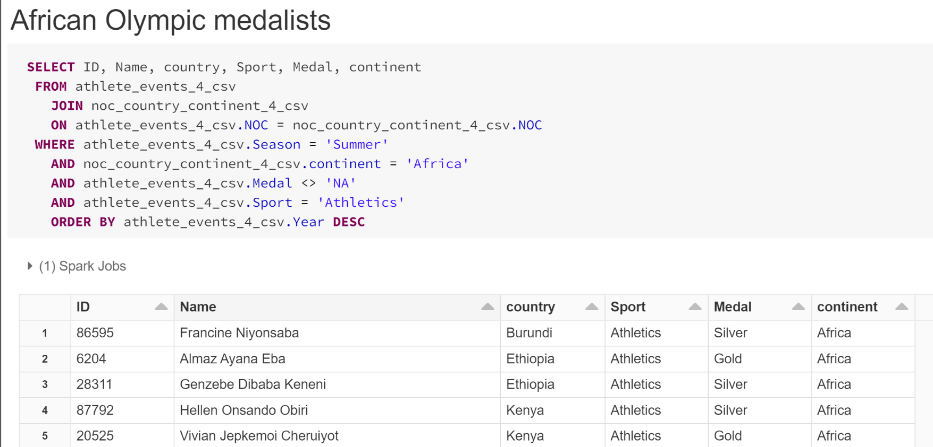
Appendix: Samples of SQL used for this Project

Slide 14
